Slide 1
Notebook

Slide 2
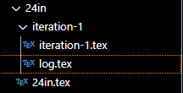
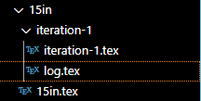

Daily logging
Each part of the notebook has a “log” file
to put day-to-day work.

Slide 3
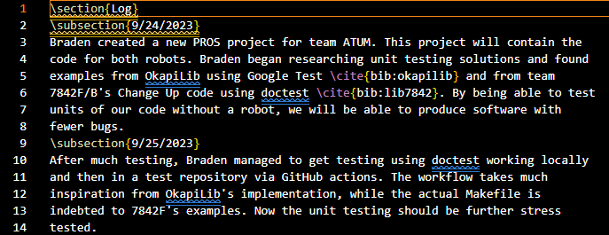
Daily logging
The logs should look like this with (M)M/(D)D/YYYY
subsections and third-person writing.

Slide 4
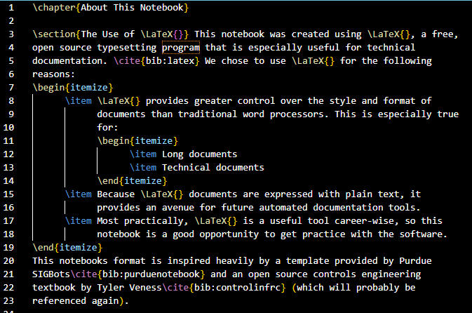
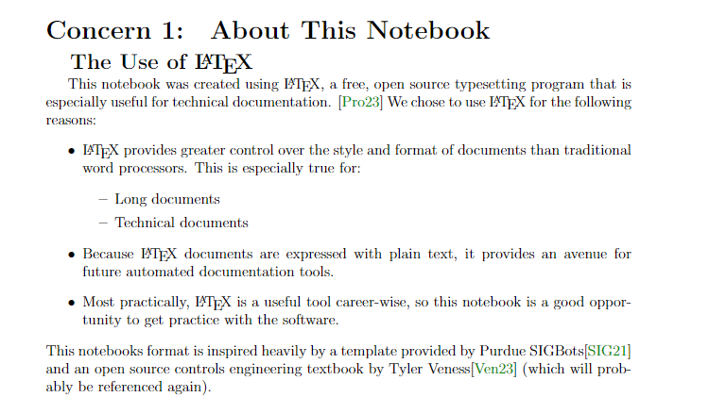
SUBJECT FILES
The design and overall history of the robot should be further expounded upon in separate easily-accessed areas.
For instance, above is the chapter “About This Notebook” going into detail about the notebook.

Slide 5

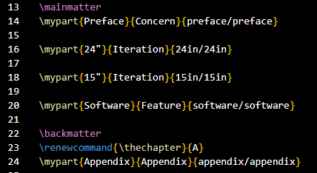

SUBJECT FILES
The subject files should be input in a “part file” the list of part files is on the right.
Think of placing pages in a binder: that is the \input command.

Slide 6
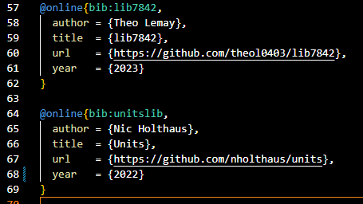
Citations
Cite resources used for design/code. Find the bibliography.bib file and mimic entries already there.

Slide 7

Citations
This is how citations should appear in the notebook, with a space before
and a period after (if at the end of the sentence).

Slide 8
Github desktop

Slide 9
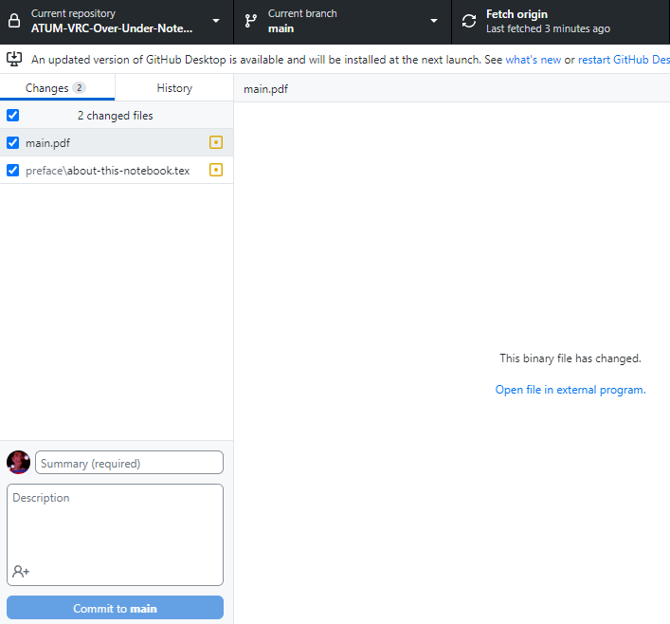
Overview
This should be the view upon
opening GitHub Desktop.

Slide 10
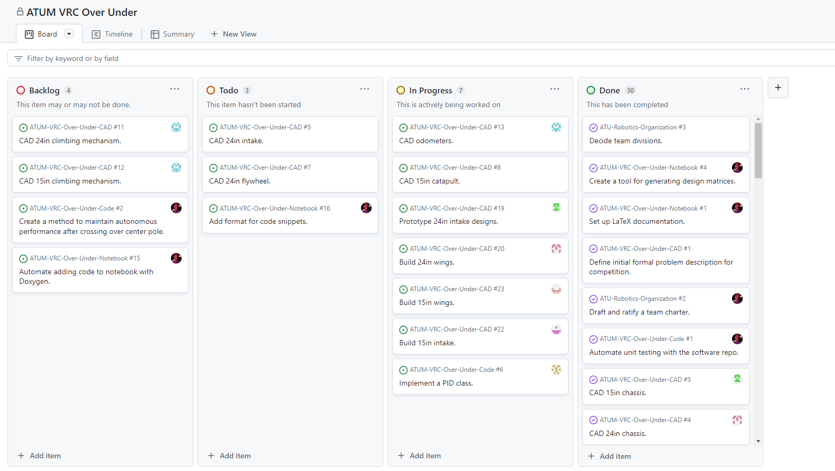
Project board
This is the board view. Items should be dragged to their
appropriate category as needed.

Slide 11
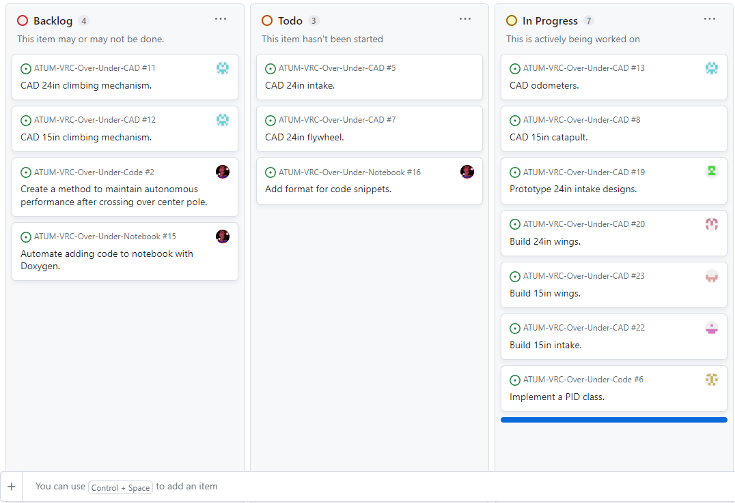
Adding an item
Click “Add item” on the desired category.

Slide 12
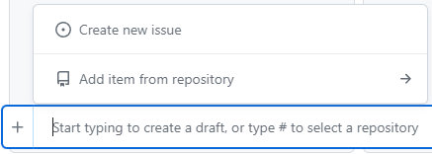
Adding an item
Click the ‘+’ and click “Create new issue.”

Slide 13
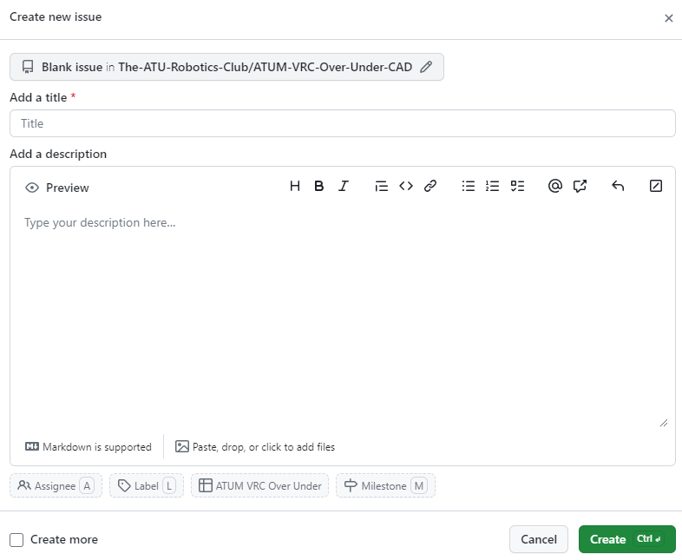
Adding an item
This should be the screen seen at this point. You may need to select a different repository depending on the task to be done. Click the “Blank issue in…”

Slide 14
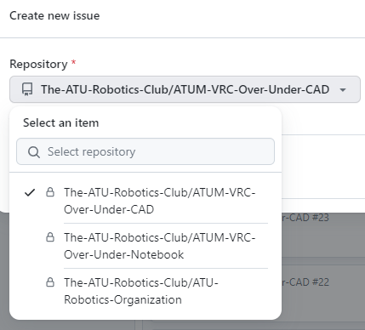
Adding an item
If you clicked “Blank issue in…” before, select the appropriate repository on this screen.

Slide 15
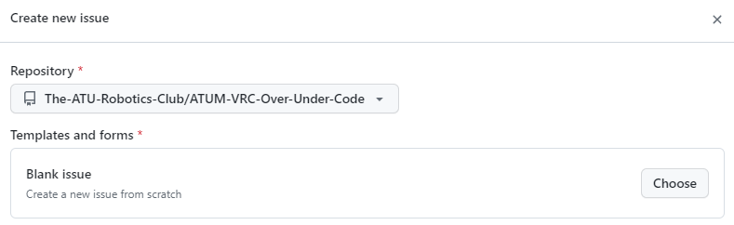
Adding an item
If you selected another repository, now select “Choose.”

Slide 16
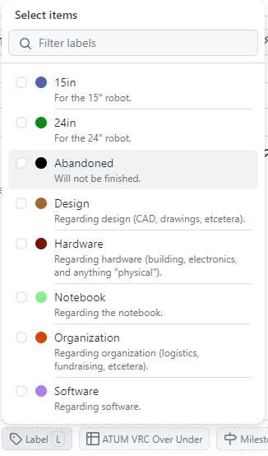
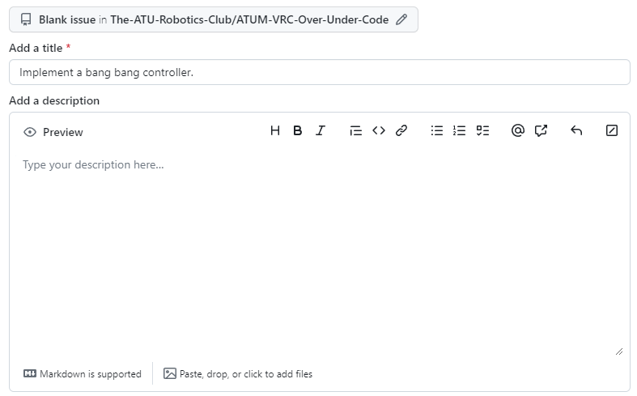
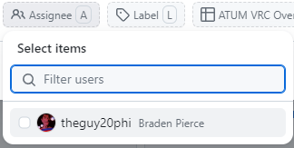
Adding an item
On the next screen, you should give an appropriate title (using same rules as commit messages).
You should also add appropriate labels and an assignee.

Slide 17

Adding an item
After the item is completely fleshed out, click the “Create” button.

Slide 18
Adding an item
After the item is completely fleshed out, click the “Create” button.

Slide 19
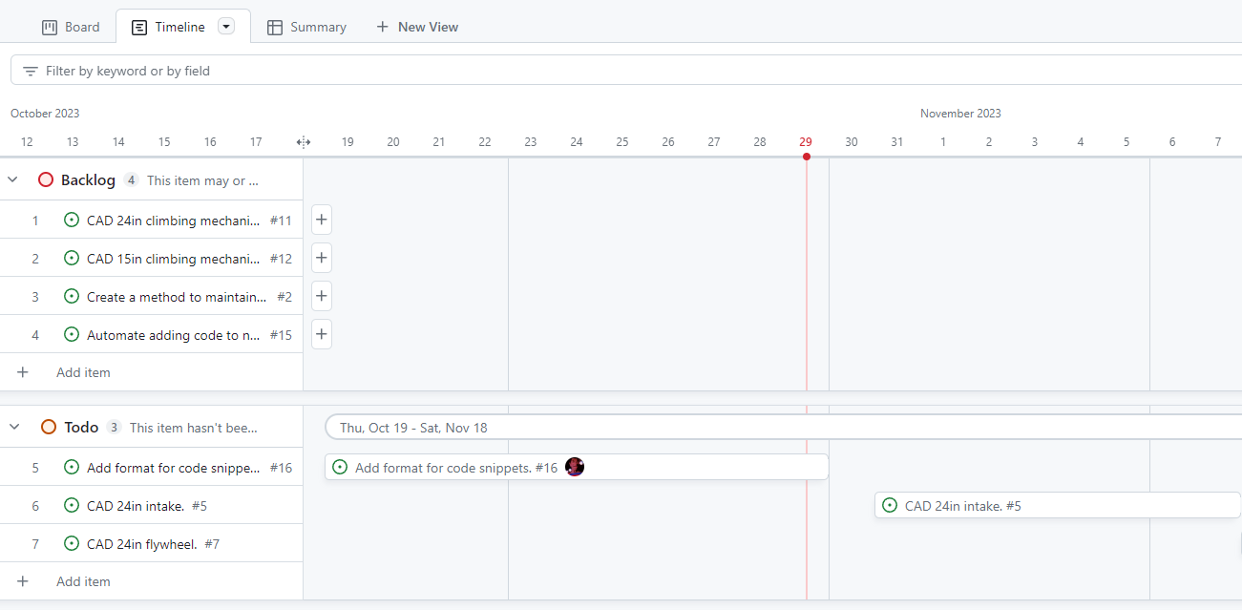
TIMELINE
On the other tab, “Timeline,” add estimated start/end dates if reasonable to
do so, or to update real start/end dates.

